Slide 1

Building a Library of Models for Parallel Network Simulation
2003/2004 4th year project presentation
Mohamed Ahmed
Khalil Yonis
Abdul-Rahman Elshafei

Slide 2

Road Map
Project introduction.
Background.
Tool in use.
The Big Picture.
Discussion.
Future expectations.
Notes:
In this presentation we will talk introduce the 4th year project, give a small back ground on its topic.
We will follow that by presenting the projects big picture

Slide 3
Project Introduction
Building a library of network models.
Simulate communication networks in a Parallel Environment.
Notes:
Set bases for future development of the library.

Slide 4
Background:
Network simulation
  Provides means to study network traffic.
  Provides a level of predictability in the network.
  Some of the simulation tools available:
    NS-2
    Omnet
    Opnet
Notes:
NS-2: a discrete event simulator targeted at networking research, being developed by the university of southern California. Information science institute.
Omnet: a discrete event simulation environment. Targeted at simulation of communication networks, successfully used in other areas like simulation of complex IT systems, queueing networks or hardware architectures as well.
Opnet: commercial tool simulating large communication networks with detailed protocol modeling and performance analysis

Slide 5
Background:
Parallel Simulation
  Reduces the cost and time of large scale simulations
  Reduces memory requirement.
  A growing research area
    Richard Fujimoto
    David Nicol

Slide 6
Motivations
Networks are ever growing.
need to plan any change in current networks.
simulation tools have not been able to keep up with the rapid development of modern networks.
Increase simulation speed.
Notes:
Importance,
Cost analysis of used equipment and their organization, to maintain max utilization, for least price.
simulation tools have not been able to keep up with the rapid increase in the size, complexity and speed of modern networks
parallel simulations improves the performance of the simulation of networks.

Slide 7
Tools used
CD++
  A tool implementing the DEVS formalism
  independent of the operating environment chosen.
  Atomic models are implemented using C++.
PCD++
  Can be distributed on parallel processors

Slide 8
D.E.V.S
D.E.V.S is a formalism that
  Was developed as a theory for discrete event models
  models can be integrated using a hierarchical approach

Slide 9
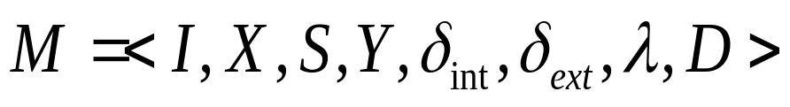
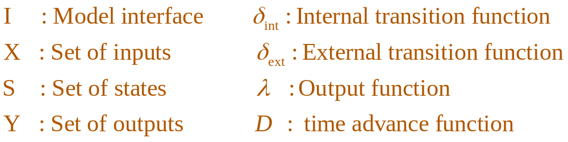
D.E.V.S
Models are defined by the following equation
Model reuse is possible through the concept of coupled models.

Slide 10
Why CD++/PCD++ ?
Easy to modify and update.
Not specific for network simulation.
Models can be connected regardless of there functionality.
Adds an extra dimension to network simulation.

Slide 11
The Big Picture: Task 1
Build a small coupled model defining the topology of a given network
Run test simulations with simple traffic models
Build a larger model

Slide 12
The Big Picture: Task 2
Study how to generate traffic to mimic the behavior of TCP
Build traffic generators (model that generates traffic in the network)

Slide 13
The Big Picture: Task 3
Port previously created (Tasks 1 and 2) models into the parallel environment
run models in parallel and test them

Slide 14
Discussion

Slide 15
Discussion: Introduction
study of the underlying principal of D.E.V.S.
Model design, and coding.
Notes:
To accomplish our goal of building a simulation tool, we first had to study the underlying principals of DEVS, so as to better structure, our models, to have them, customizable, and most important flexible to change

Slide 16
Discussion: Library Design
Basic Networking Technology
  Different Topologies.
  TCP Reference Model, RFC 793.
  Network Protocol (IP) RFC 791.
  Routing Algorithms, RFC 1058, 2328, 2453.
Basic inter-Networking Devices.
Notes:
Looking at current industry standards, a library for network simulation, would have to deal with different aspects of networking such as the topology of the network, the reference protocol stack used and the devices operating within the network. We have decided on a set of protocols and devices based on their heavy use in every day to day work.

Slide 17
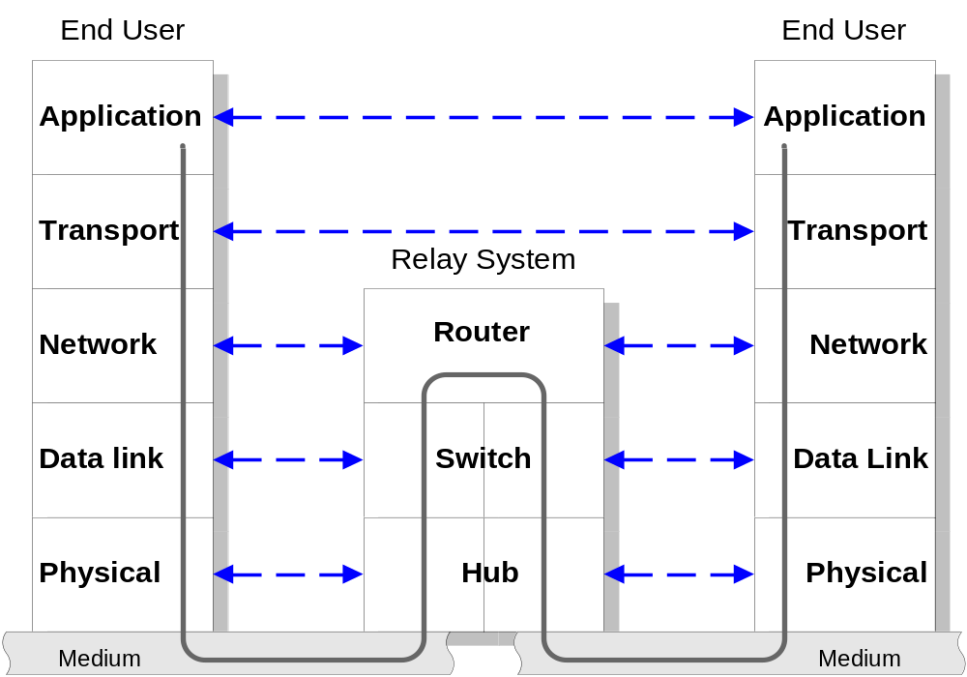
Discussion: Model Design
Notes:
Discussion model design,
Any network consists of clients that produce data, and a relay system to transfer the produced data through out the network, to its destination. We are interested in packet switched networks, where the clients are hosts and the relay system , depending on the layer of operation is either a router, switch, or a hub.

Slide 18
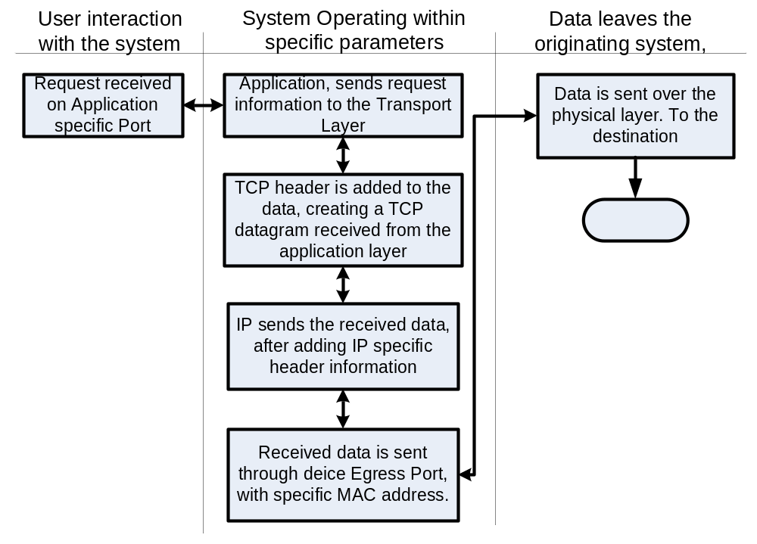
Host Design
Notes:
The host is the described as a generator and sink for data on any network. We have decided to break the host into 3 areas.
The first being the user interaction area, where the user inputs requests to the system, in terms of data to be sent from a certain source (self), through a certain application, to a certain destination. The second being the Host operational area, where appropriate protocol headers are generated and added to the data to prepare it to be sent through the network. This area as shown has the bulk of the host operations hence the name. third and last is the signalling area, where the data is sent through the physical layer, to the default gateway of the host which will route the packet, according to information embedded in the packet it self,

Slide 19
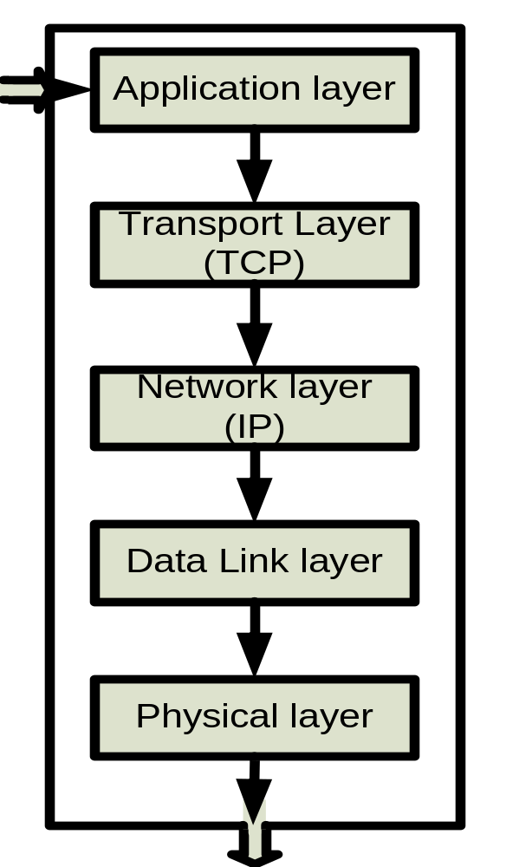
Host Design
Host design implements the TCP/IP reference model.
It consists of 5 models, all together defining the Complex host Coupled model.
Notes:
That is accomplished by means of dividing the host into models each corresponding to a layer on the TCP reference stack.
The application layer model lies in the user interaction area, where transport network and data link layers models are in the operational area.
And finally the physical layer model lies in the signalling area
layers 1 and 2 are still work in progress.

Slide 20
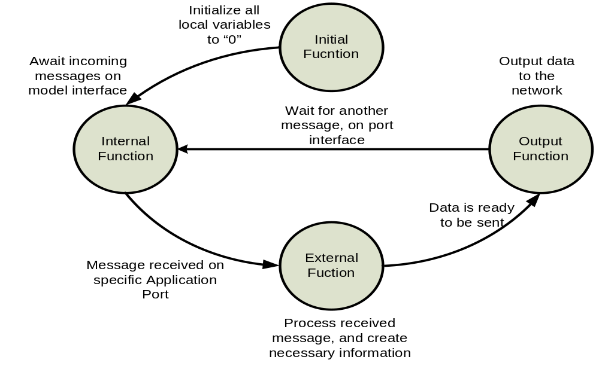
Host Coding
Notes:
Model coding is simplified by overloading a set of four functions which are initial, internal, external, and output function.
The initial function, sets all local variables to their designated values, and when the time advance function is over, the model then proceeds to the internal function where it awaits incoming events on it input interface, once that takes place, the external function process the received data and create any necessacery headers, and prepare the data for output in a certain form.
As soon as the external function finishes, the output function is invoked to output the prepared data to the network, and finally the model is again in the internal function where it merely awaits input to function again,

Slide 21
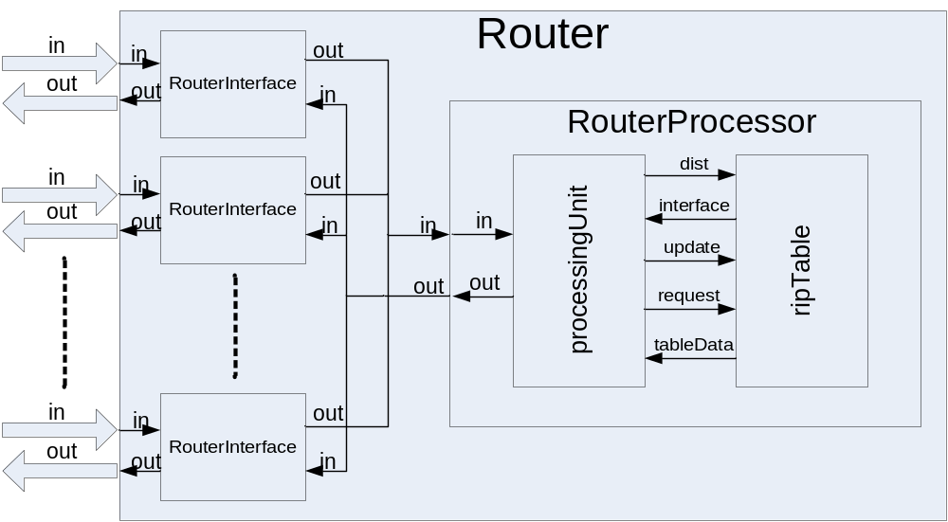
Router Design
Notes:
Routers are designed to be allow for connecting “N” number of networking devices (be a host or any other device, that generates routable packets)
Once a packet (which is the form of data present in the 3rd layer of the TCP reference frame) is received through the router interface, the router processor, identifies the packet type, and perform the required operation

Slide 22
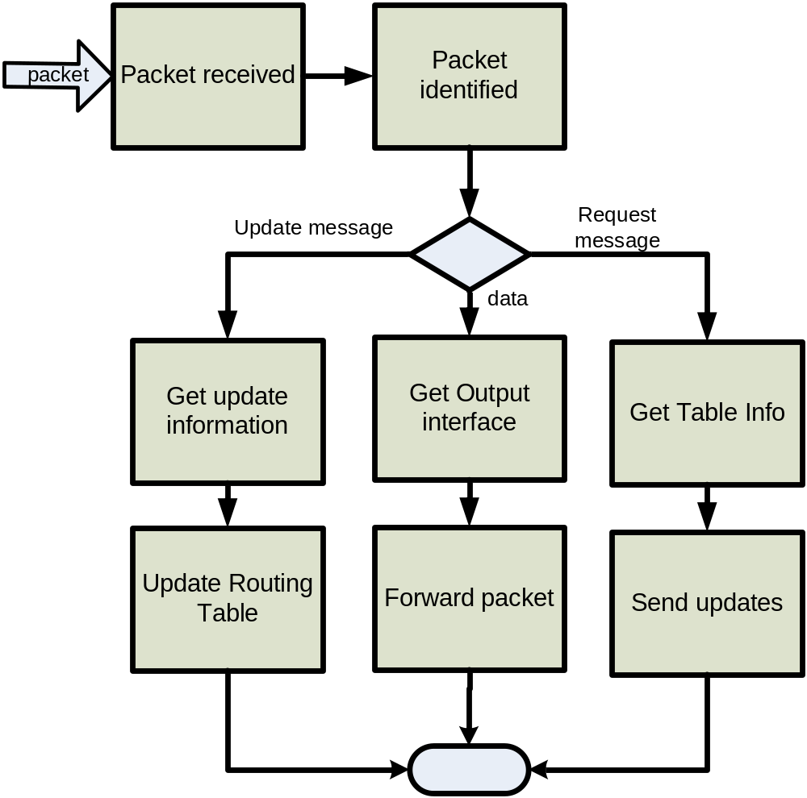
Router Design
Notes:
Packets received by the router could be of 3 types: either data to be routed, update information, to update the routing table, or a request for updates, by another router. Here the operation of each of those packet types is defined.

Slide 23
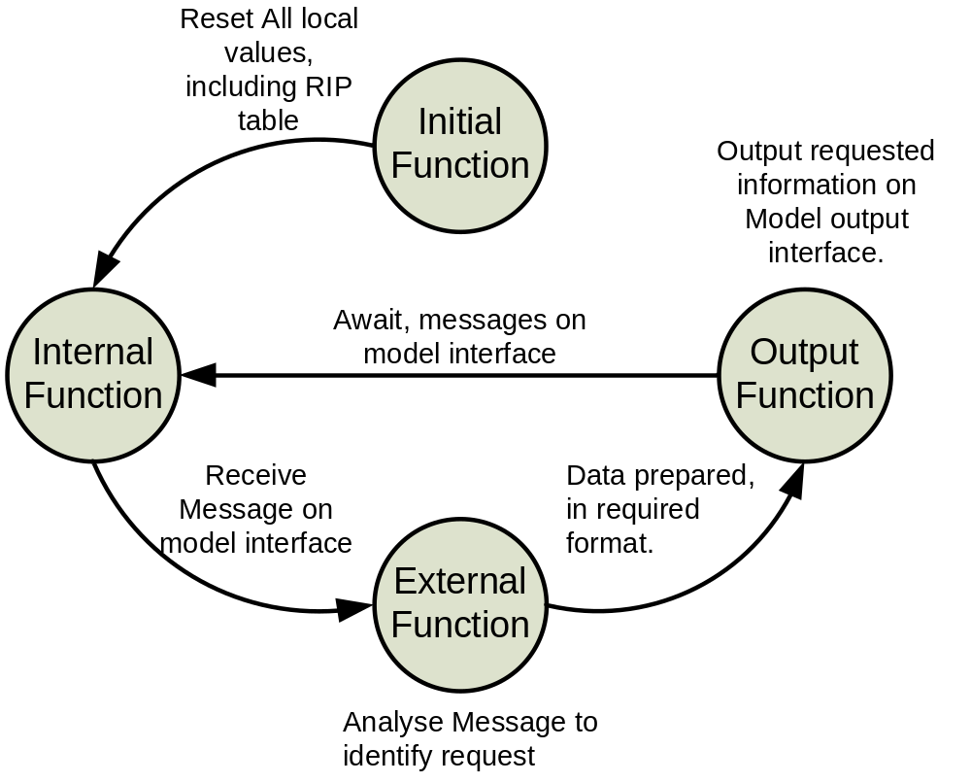
Router Coding

Slide 24
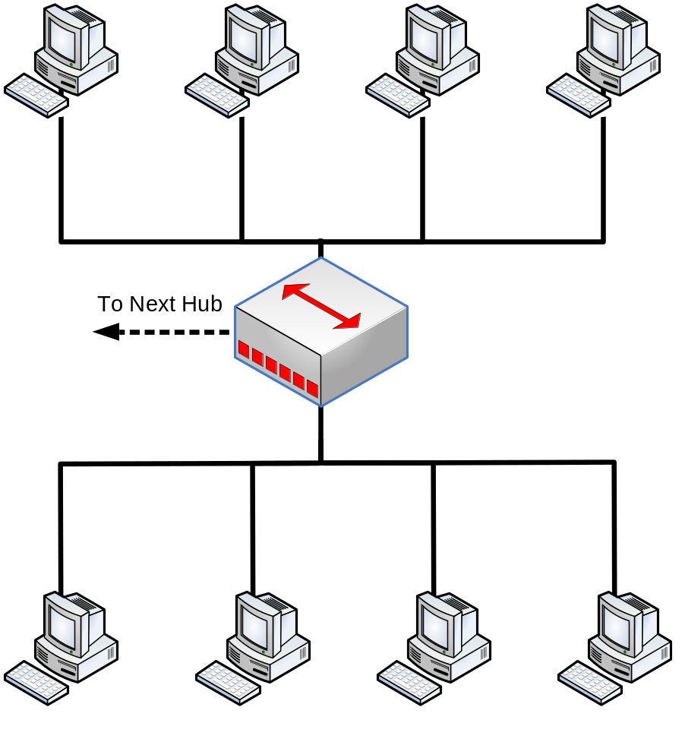
Hub Design
Hubs are Simple Layer 1 devices.
Data is generated without distinction.
LAN segments are simple Hub interconnections.
Notes:
Hubs are devices of the collision domain, hence all incoming data on the ingress port, is generated to all connected
Ports on the egress port.

Slide 25
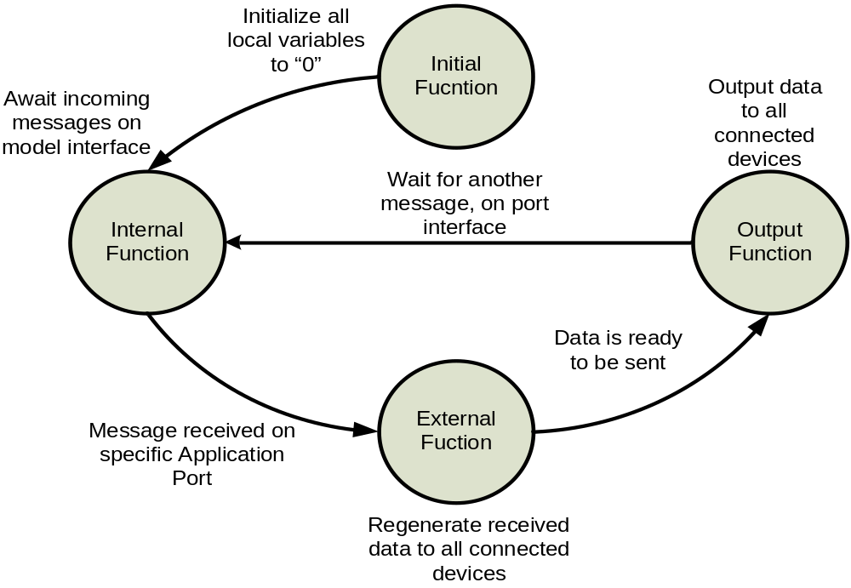
Hub Coding
Notes:
The Hub is designed to follow the 5-4-3 rule: The 5-4-3 rule divides the network into two types of physical segments: populated (user) segments, and unpopulated (link) segments. User segments have users' systems connected to them. Link segments are used to connect the network's repeaters together. The rule mandates that between any two nodes on the network, there can only be a maximum of five segments, connected through four repeaters, or concentrators, and only three of the five segments may contain user connections.
It is written so as to be used to create a LAN Segment

Slide 26

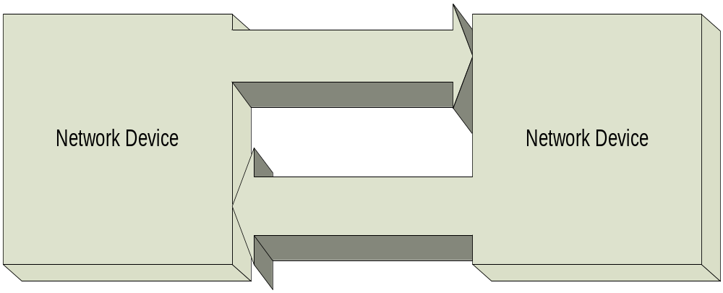
Simple Network
Home/ Small office private network
Notes:
A simple network is used to simulate a home or a small office network, from the network it is viewed as a single entity, while from within it’s a couple of network devices, or more.

Slide 27
Work in Progress

Slide 28
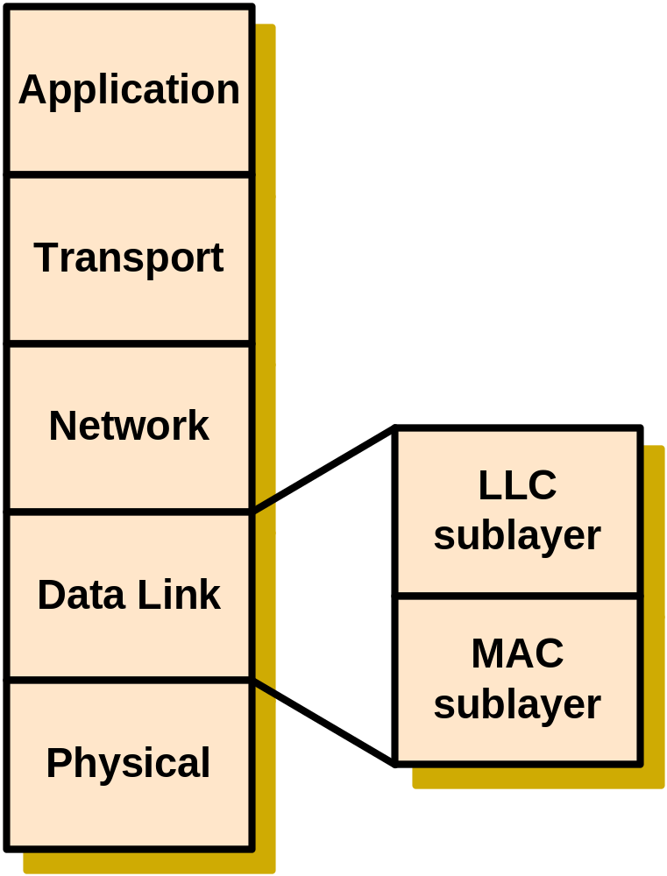
Modelling the Data Link Layer
MAC protocol using CSMA/CDMA
LLC protocol

Slide 29
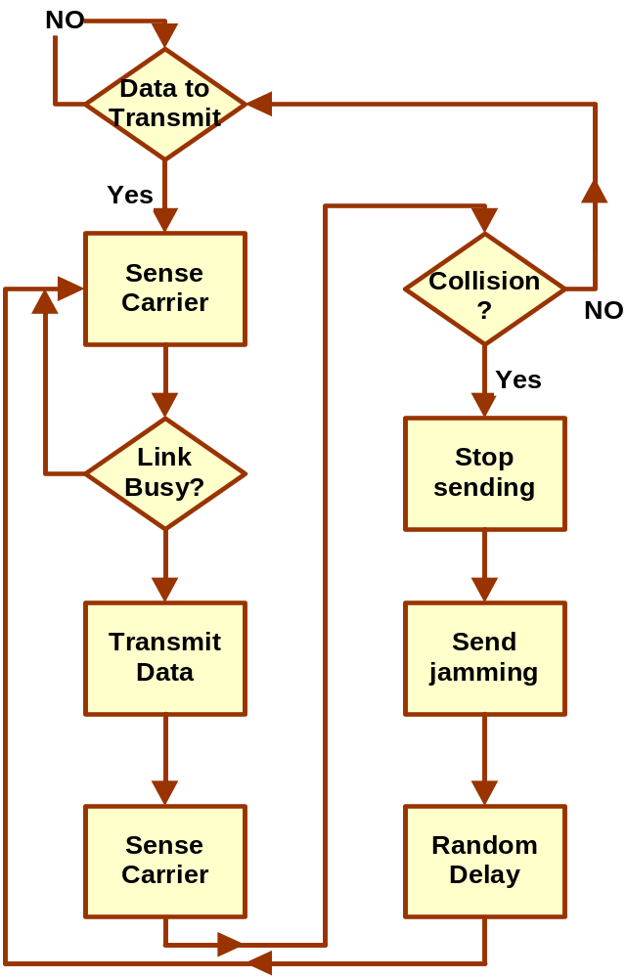
Modeling the Data Link Layer
Medium Access Control
Controls access to transmission link
Carrier Sense Multiple Access with Collision Detection

Slide 30
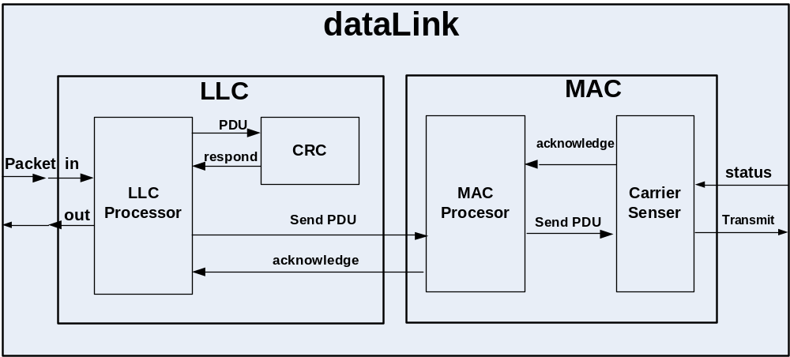
Modeling the Data Link Layer
Logical Link Control
Framing the packets
Error control

Slide 31
Work in Progress
Enhancing Routing Algorithms
Dijkstra algorithm for finding routing metrics and interface.
Developing realistic updating methods based on RIP version 2

Slide 32
Work in Progress:
Parallel Simulation
Gather statistical data on the parallel simulator(PCD++)
Enhance model structure according to gathered data
Performance: PCD++ Vs. CD++
Notes:
The parallel simulator has a wealth of data to provide, including time constraints, and complex message passing (in classes, hence passing more than just primitive types)
CD++ output in the various models will be used as a baseline to estimate the performance of the parallel models
Model enhancement will be in terms of making the models more compliant to the protocols at hand (RIP, TCP, IP, …), keeping in mind the restrictions of discrete event simulation.

Slide 33
Future Work

Slide 34
Future Work
Model the Physical Layer
Enhancing library models.
Making the models more generic.
load balancing algorithm Comparison on the parallel simulator.
Notes:
*****We aim at gathering message time information from the network, to better implement algorithms such as the Jacobson algorithm and to analyse the network in general
Load balancing techniques, are techniques used to distribute the load of the simulation on various computers, this is used in parallel simulation, by comparing a predefined test network with multiple techniques we can derive which is more suitable for this type of parallel simulation. Of course having established a baseline through comparing PCD++ and CD++ will greatly affect this comparison.

Slide 35
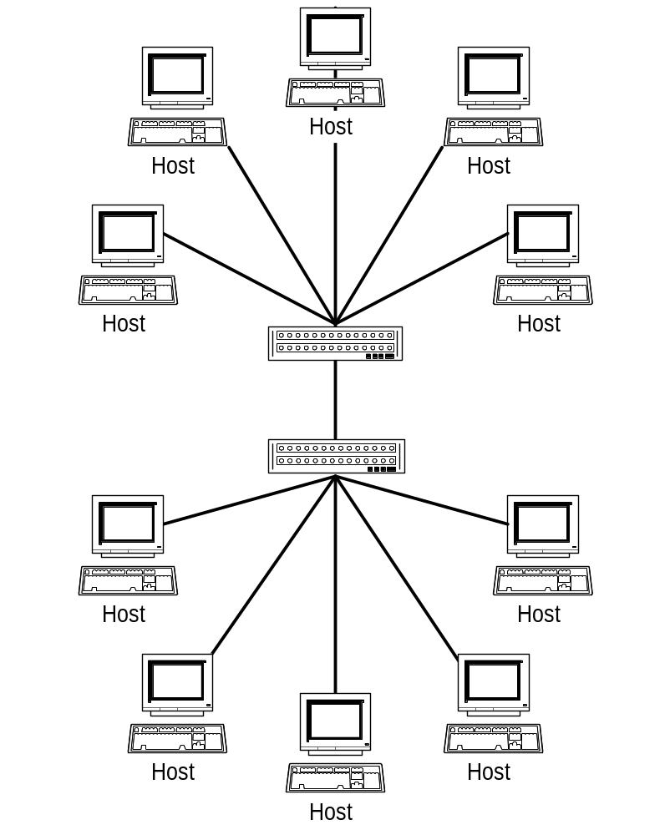
Expanding the Network
Creating different instances of our current
LAN model and interconnecting them
We should end up with
a W.A.N (wide area network)
Notes:
Network expansion is planned in a hierarchical method, where interconnecting currently developed models to create larger stand alone models
The bigger models (the proposed WAN) will be used to create even bigger networks. It is the bigger vision, that we will use such expanded models to build a scalable simulation model of the internet at a certain point in time.

Slide 36
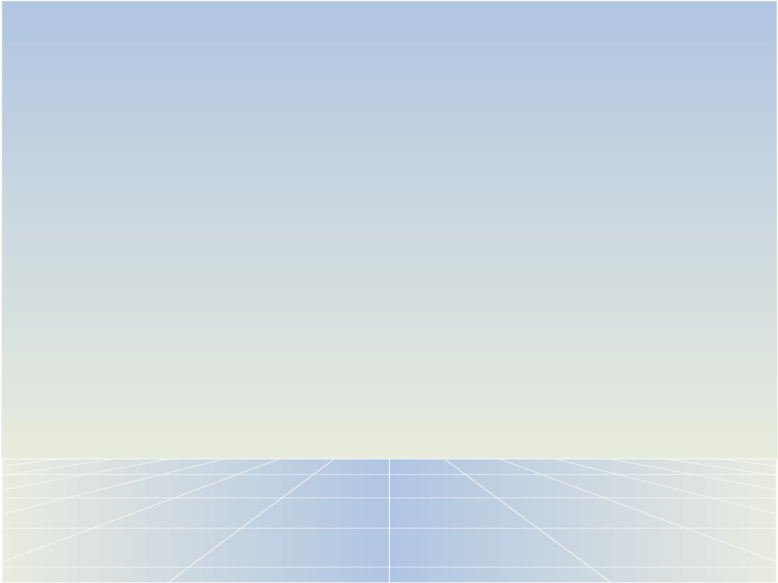
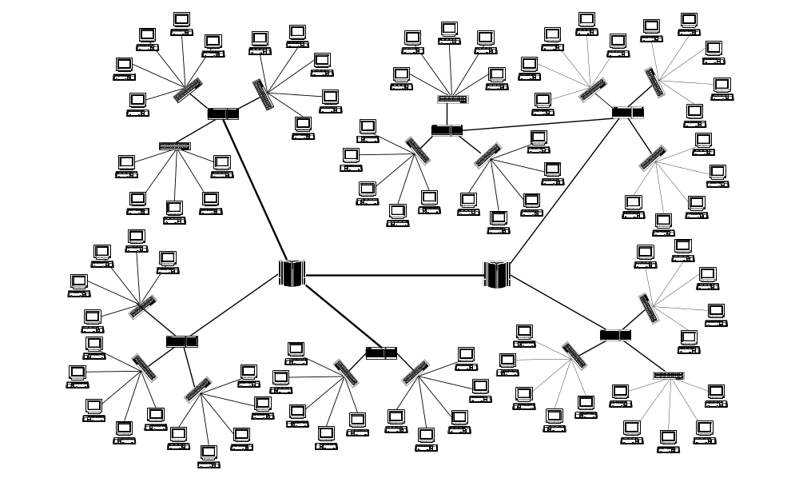
WAN

Slide 37
Future Expectations
Mapping user input from a graphical user interface (G.U.I) to model files (MA files).
Automatic analysis of topology maps.
Notes:
The project in its final version, should be able to accept input from users in a manner, that would allow for users with little or no knowledge of C++ programming language or maybe even CD++/PCD++ to use the tool.
For that we require a graphical user interface that would accept user input (in the form of clicks, or window forms input) to generate CD++/PCD++ files to incorporate more models in the simulation.
Also a topology analyser must be developed to allow for the input of large scale networks for performance, utilization and general network analyses

Slide 38
Conclusion
The purpose of the project is to build a library of “D.E.V.S” models to be used in the parallel simulation of communication networks
Models are organized to follow the TCP/IP Protocol Architecture
Models are designed to be easily changed according to the simulation needs

Slide 39
Conclusion
Future expectations will expand the project to a functioning tool.
The final version of the tool, should be able to analyze, and create topology maps, according to user inputted parameters to the simulation.

Slide 40
Contact Information
For further questions, or concerns we may be contacted at:
  masproject@yahoogroups.com
  mohamedmahmed@islamway.net

Slide 41

Questions

